Slide 1
Disaster management using Lora
TEAM MEMBERS : Archit Shukla
Tahenan Haroon Shamashapure
Mohammed Abu Zaid Younes Abu Zaid
Pravallika Modala Venkata Shiva Naga
Bharath Chandra Kanumalli
COURSE : 701- Internet Of Things

Slide 2
Motivation
In a world where natural disasters continue to disrupt lives and communities, there is an urgent need for innovative solutions that can bridge the gap between those in distress and the rescue teams dedicated to saving lives.
Each disaster brings with it a unique set of challenges, from collapsed infrastructure to individuals trapped in their homes without access to essential resources. Our project aims to bring hope and relief to those trapped in the disaster. By leveraging cutting-edge technology.
Focus of our project is the power of real-time communication. When disaster strikes, every second counts.
Our system allows those in distress to send live messages through voice detection, which are then transmitted via LoRa technology to the Gateway.
Gateway acts as a Blackbox that holds all the data locally.
From there, the data is securely sent to the cloud and made accessible through our frontend website.

Slide 3
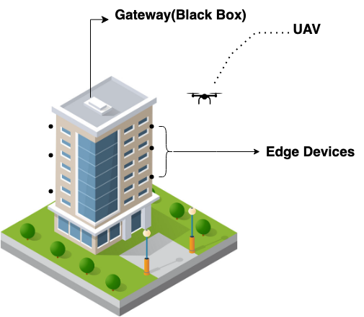
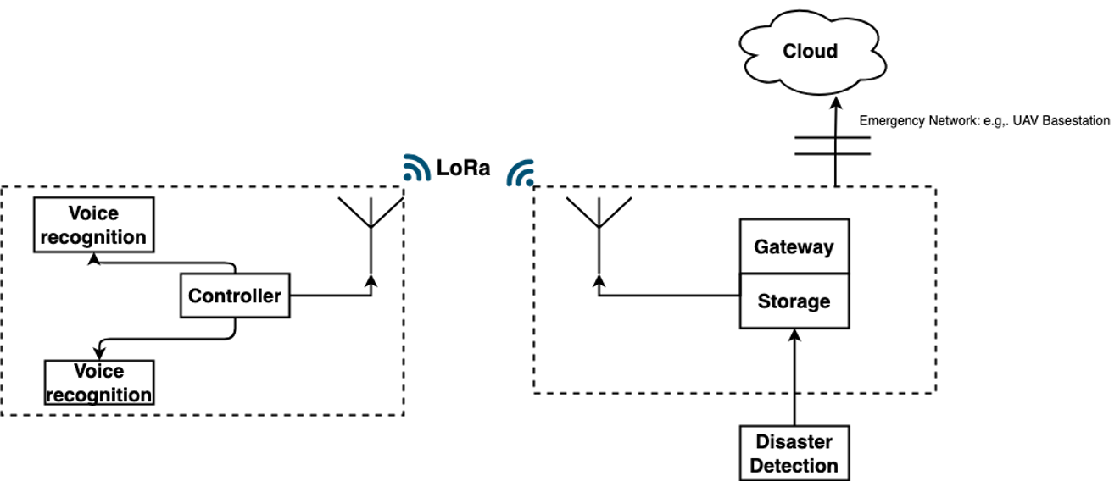
Solution Overview

Slide 4
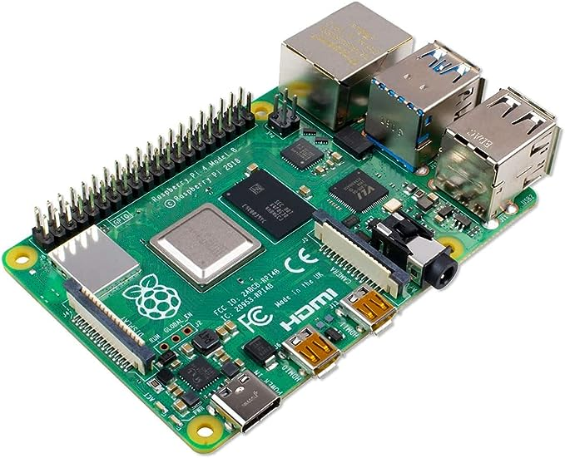
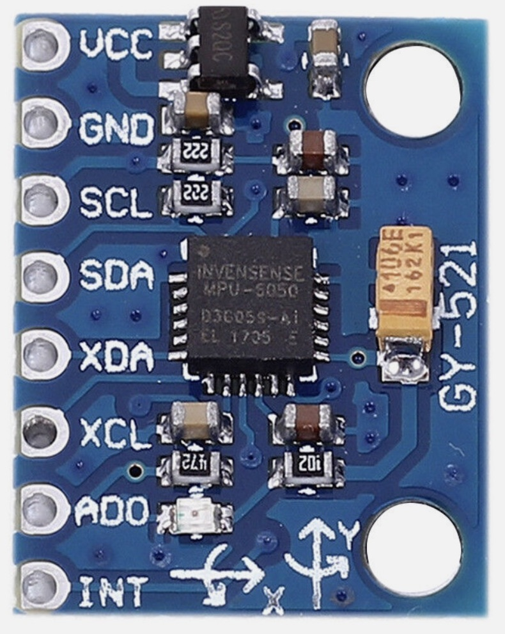
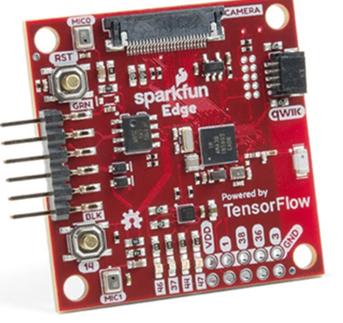
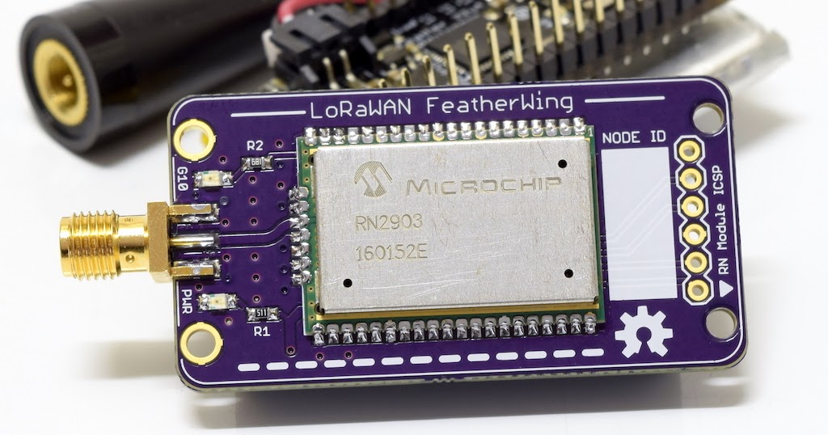
Hardware components
2-Raspberry Pi 4 Mod Quad Core 64 Bit Wi-Fi Bluetooth (4GB)-py
2-Lora-RN2903A-py
2-Edge development board-dev-15170
Accelerometer-GY-521
Vibration Sensor Module-HiLetgo
Grove - Water Level Sensor
Breadboard
Jumper wires
Software
Language: Python, JavaScript, Html
ML: Scikit-learn, TensorFlow
Database: firestore Firebase, SQLlite DB.

Slide 5
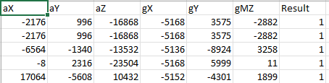
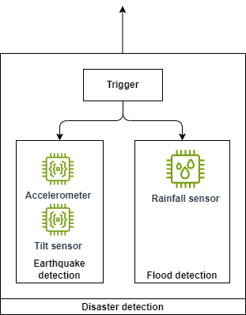
Disaster Detection
Earthquake Detection:
Utilizes a Random Forest classifier.
Employs both accelerometer readings and tilt sensor digital outputs.
Flood Detection:
Incorporates a rainfall detection sensor.
Features an inbuilt threshold for water droplet detection.
Operational Design:
Functions on two separate threads.
Employs a global variable outside the detection functions.

Slide 6
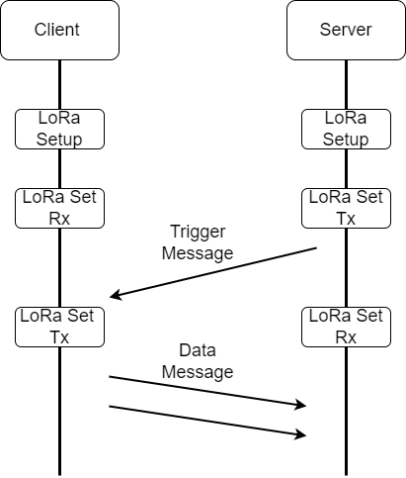
LoRa Communication : Point To Point
Data Flow
LoRa Settings
Client, Server Setup LoRa Settings
Client Awaiting Trigger from Server
Shifts to Tx Mode and start sending data
LoRa Setup
Frequency, Spreading factor
LoRa Tx
Setting Data Rate
Data Encoding
LoRa Rx
Packet Window Size
Data Encoding
Advantages :
• Fast Transmission
• Free License Band
• Cut of cost of Gateway
• Longer Distance

Slide 7
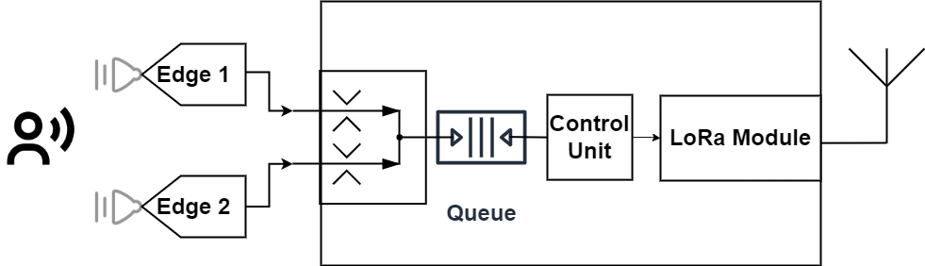
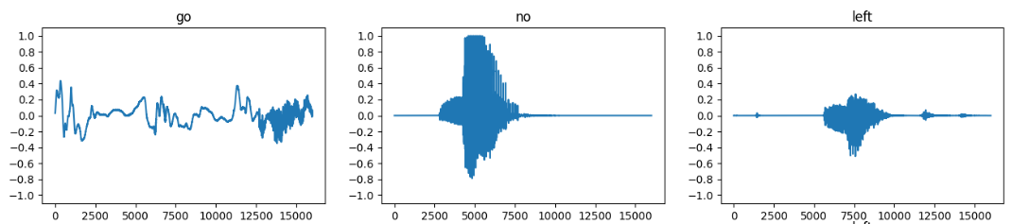
Edge : MicroSpeech Data
Data Collection
Inbuilt Microphone Module
Edge Processing compatible : Sparkfun Edge Module
Data Processing
Dataset : TensorFlow Audio Dataset
Keyword Detection Model : yes and no
Data Buffer
Queue to ensure no data loss
As LoRa Tx and Data Rx timing vary
Data Synchronization
Multithreading to simultaneously collect data from both the edge

Slide 8
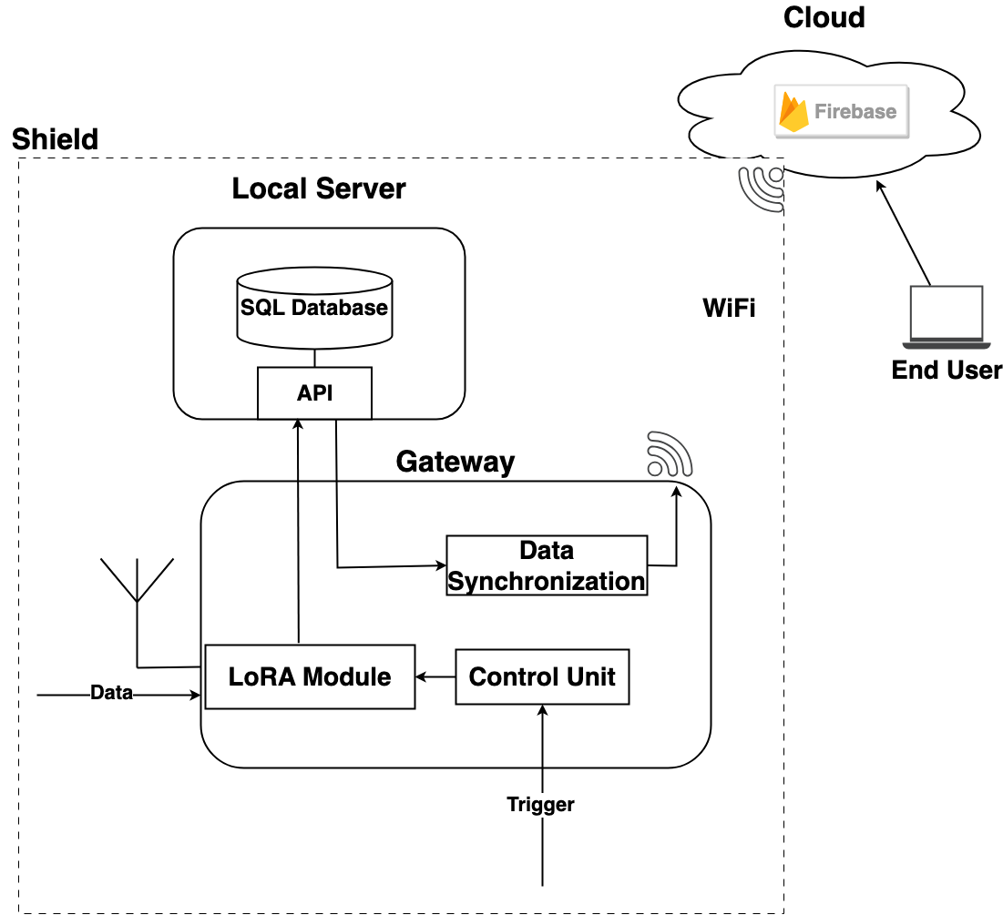
Black Box
Control Unit Operations
Receives triggers from disaster detection and configures LoRa module to broadcast triggers to edge devices.
Local Server
Manages communication with edge devices.
Ensures data storage during network downtime.
Data Synchronization
Automatic data syncing with the cloud upon network reestablishment.
Real-time Accessibility
Firebase SAS enables real-time access for end-users.

Slide 9
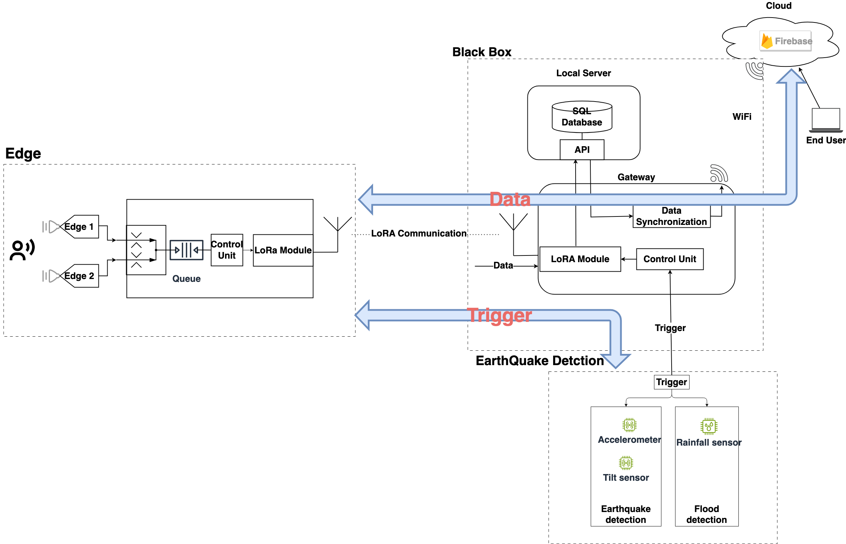
System Diagram

Slide 10
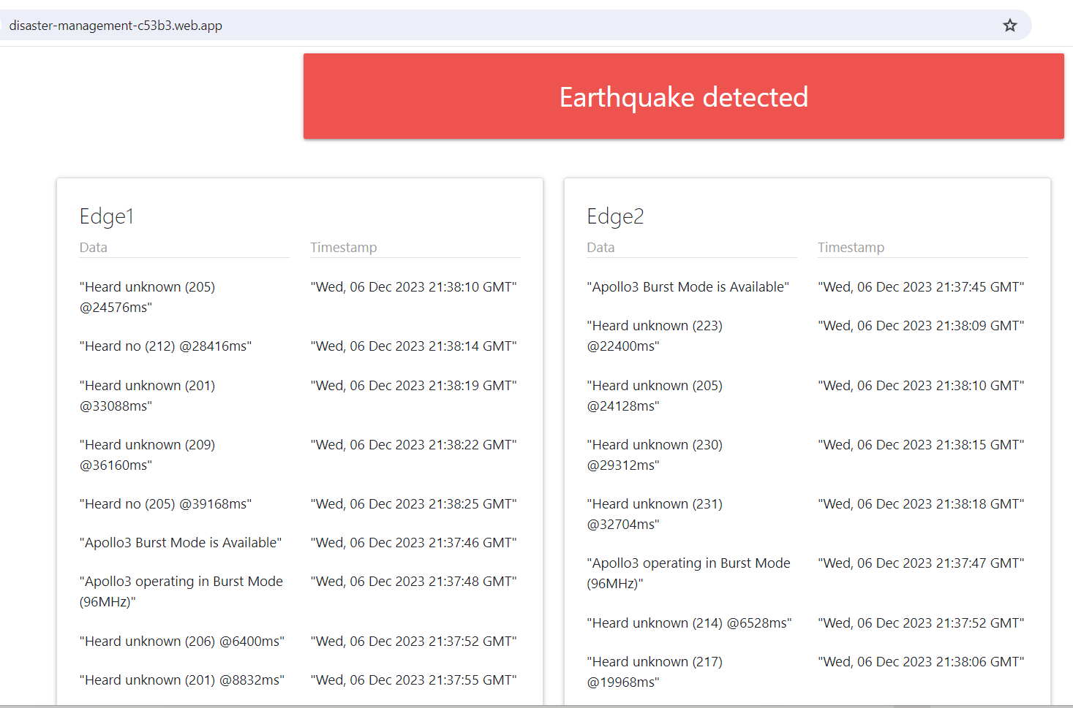
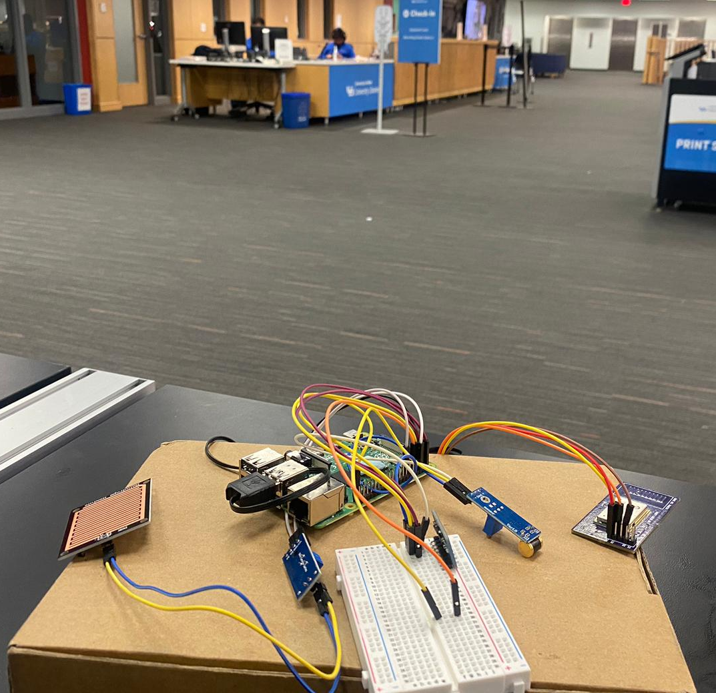
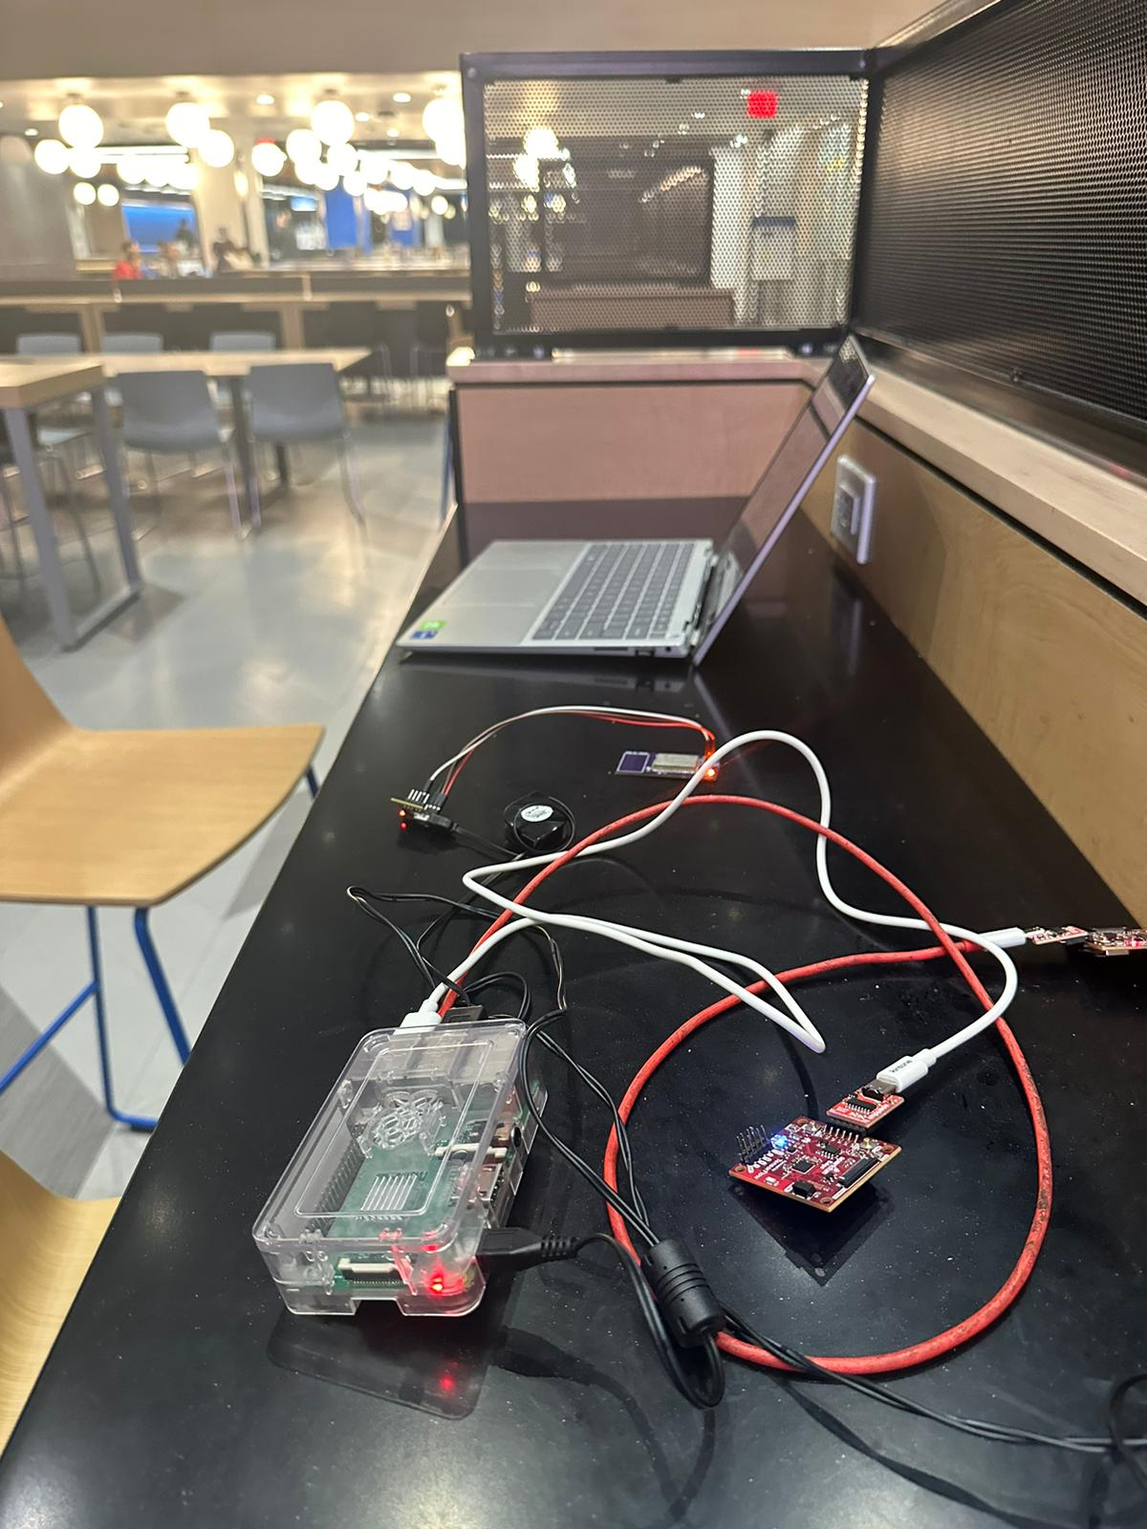
Conclusion
This model, combines voice recognition with LoRa wireless communication to provide a robust solution for real time data transmission during earthquakes and floods.
This can enhance emergency response efficiency and play a pivotal role in improving disaster management.
Gateway
Edge

Slide 11
Limitations and Future Perspective
LoRa Communication
Interference from other data transmission using the same band.
Security : LoRa Security Protocols can be utilized.
Data Packets : Longer range needs tuning the receiving packet size.
Edge Speech Processing
Model accuracy need enhancement. Current accuracy: 82%.
Include more keywords to be detected.
Data and Network Synchronization
Other network can be used: LTE/5G using srsRAN.
UAV Flying base station can be modeled by moving USRP's around.
In case latency critical application Mobile Edge Computing can be used instead of the cloud.

Slide 12
Thank You
Any Questions ?

